Slide 1
GEOMETRIC CONVERSION CALCULATOR

Slide 2
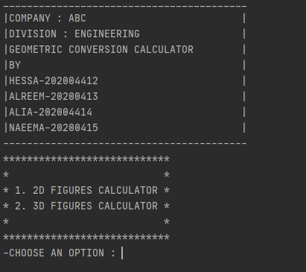
WELCOME SCREEN

Slide 3
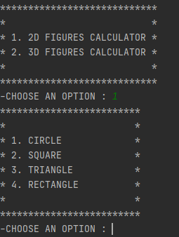
2D FIGURES

Slide 4
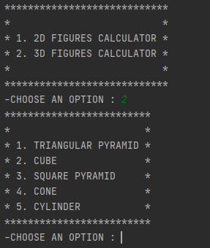
3D FIGURES

Slide 5
UNITS
If user selects any figure from 2D or 3D images. The program asks user about the units in which the user will enter values and the units, user wants to convert them into and display the calculations.

Slide 6
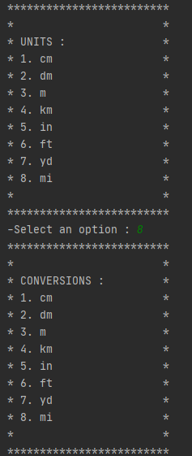
UNITS(OUTPUTS)

Slide 7
VALUE INPUTS
After taking input units and conversion units, the program asks user about the relative values of the shape for calculating the desired results.
The results for 2D include the perimeter and the area of the shape.
The results for 3D include the volume and the surface area of the shape.

Slide 8
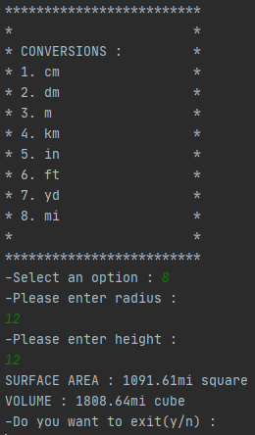
VALUE INPUTS(OUTPUTS)

Slide 9
EXIT
The program, at the end, asks the user if he/she wants to exit the program.
If user enters ‘y’ then the program ends.
If user enters ‘n’ then the program restarts.

Slide 10
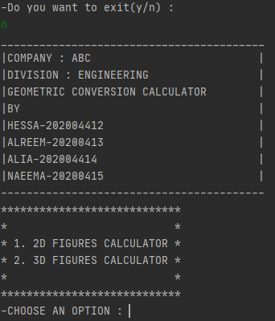
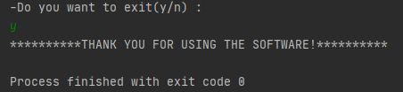
EXIT(OUTPUTS)

Slide 11
CHALLENGES AND TAKEAWAYS
The challenges I faced included:
Logic construction : About how to convert the inputs according to the desired user conversions.
Display Outputs : In what format should the output be so that it is neat and tidy.
Now any conversion related problem can be solved easily after making this project.

